Slide 1
6th Grade BAnd
While you wait, please get to know some of the other band families! It helps to have a support system if you ever need assistance, your student needs a ride, you have questions, etc.

Slide 2
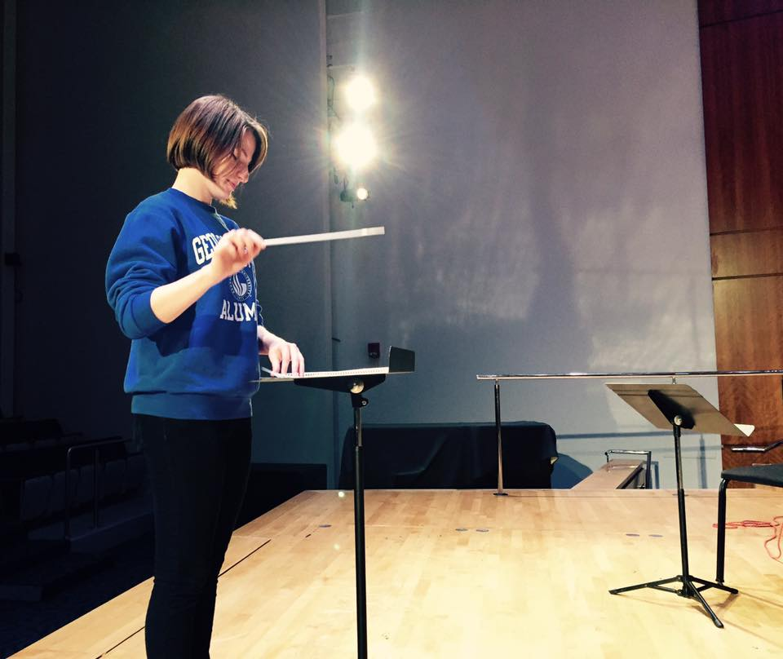
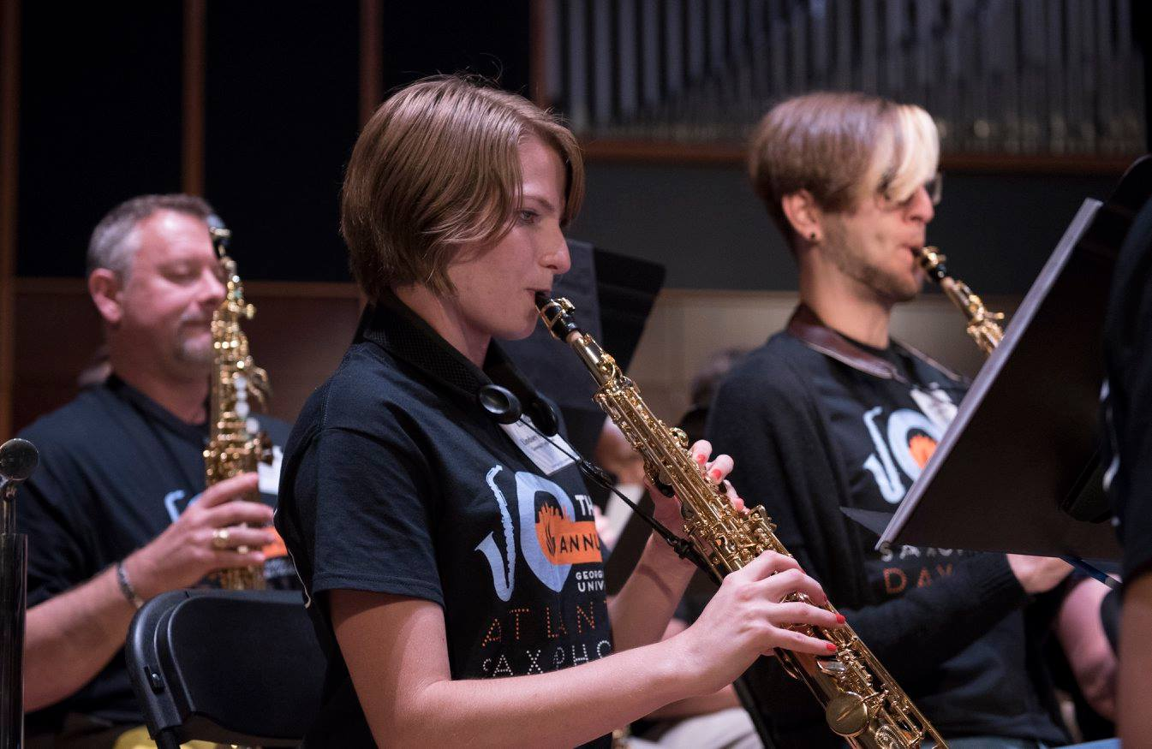
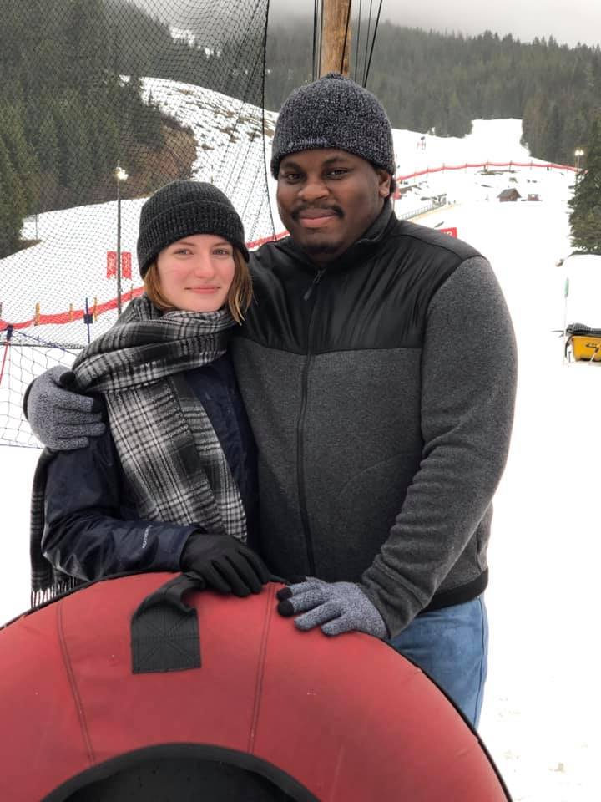
About Mrs. Foster
Go Panthers!
Woodwinds!

Slide 3
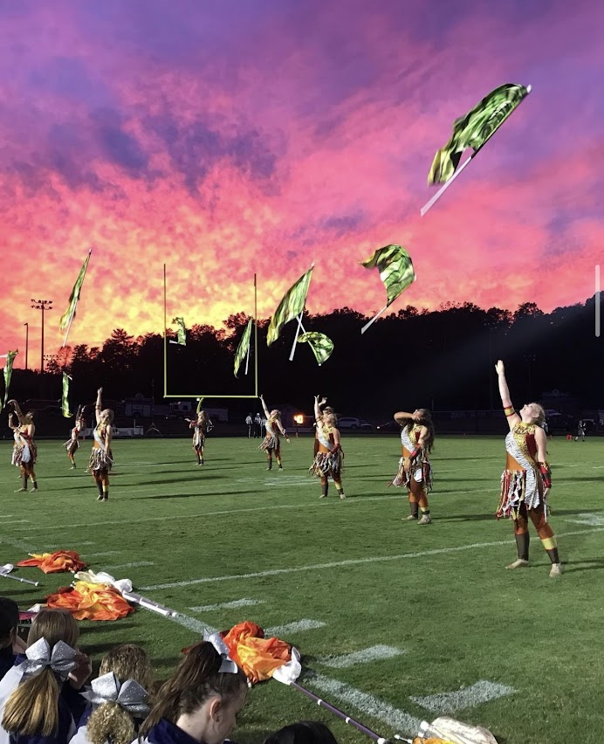
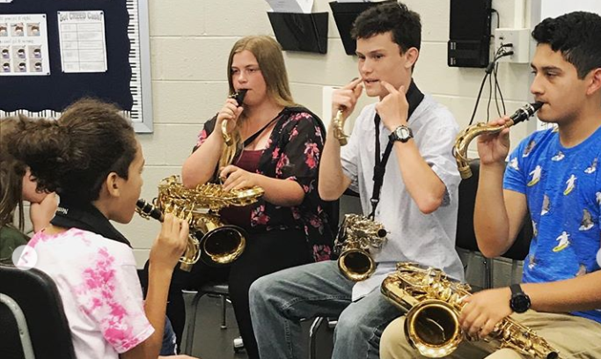
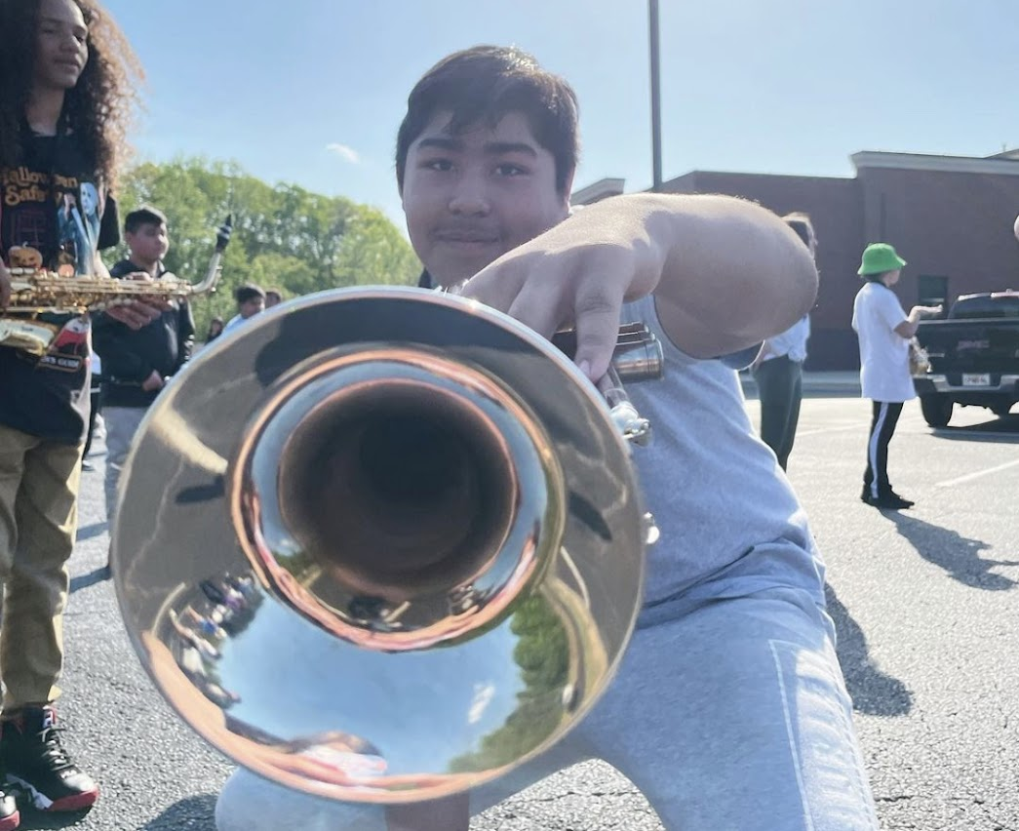
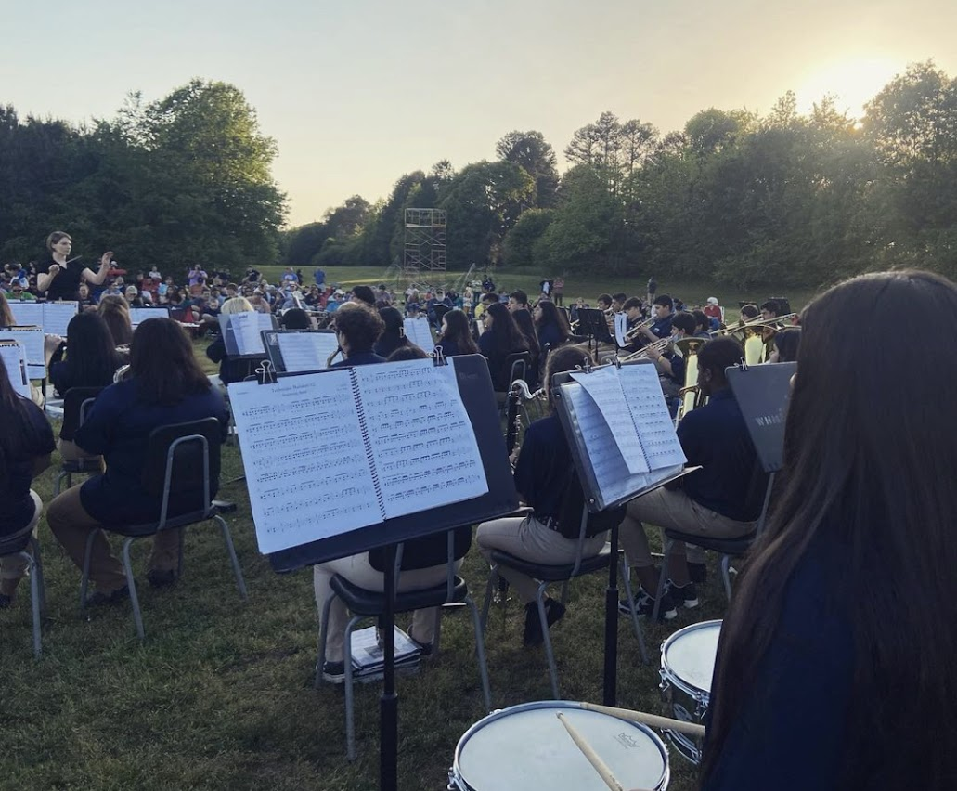
What is Band all about?

Slide 4
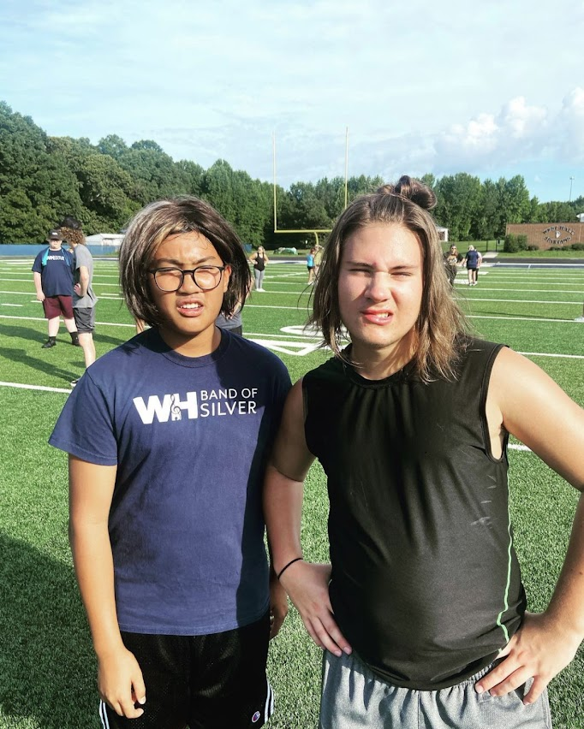
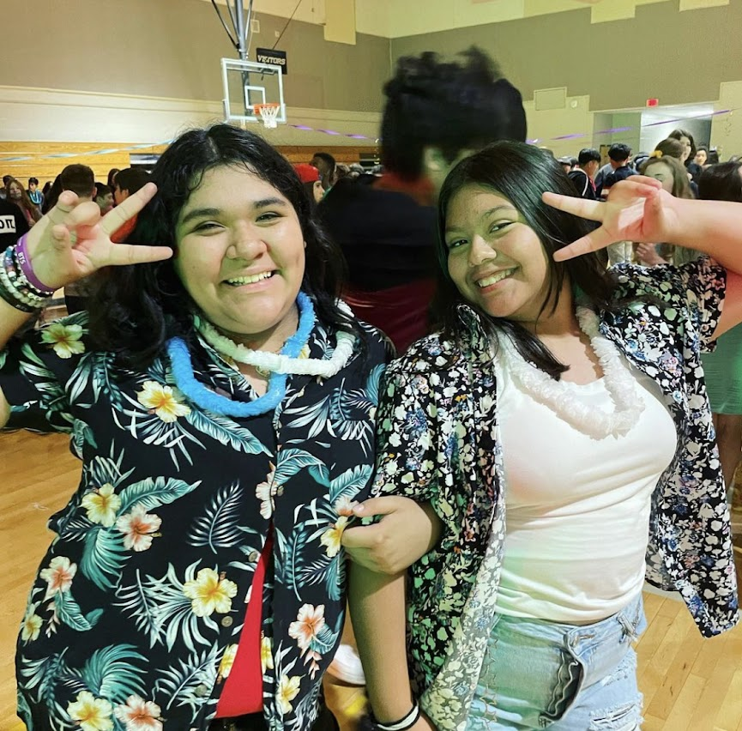
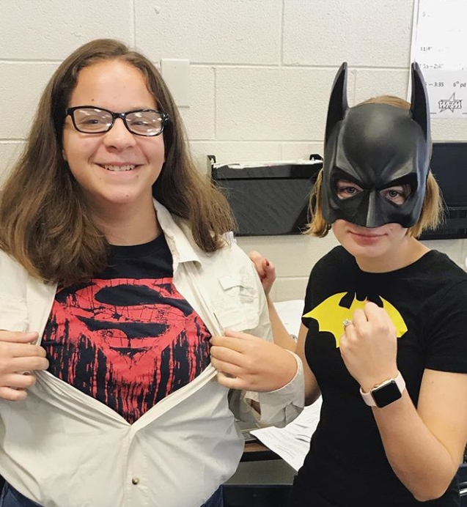
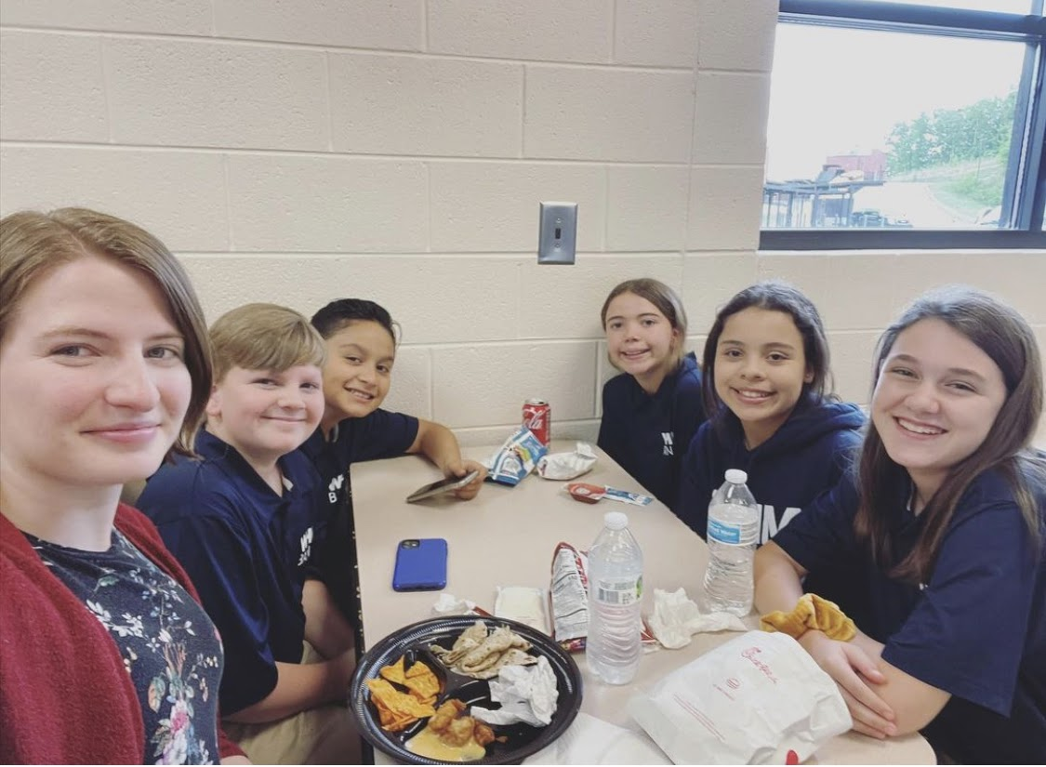
FUN!!!

Slide 5
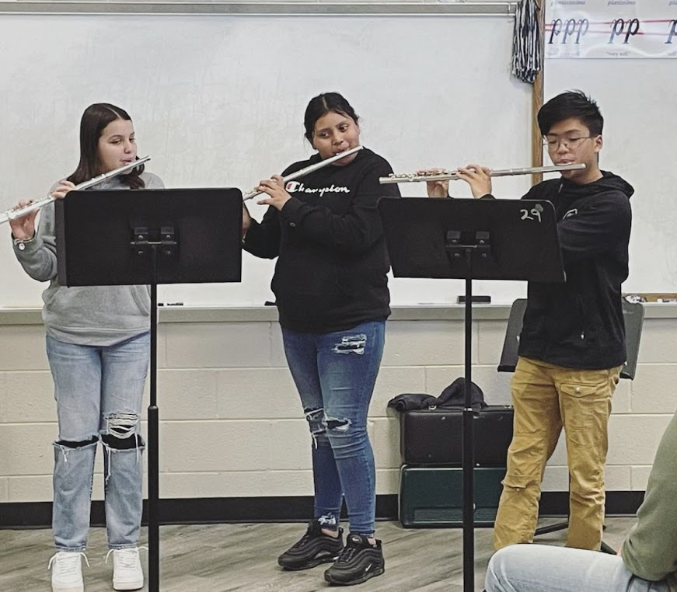
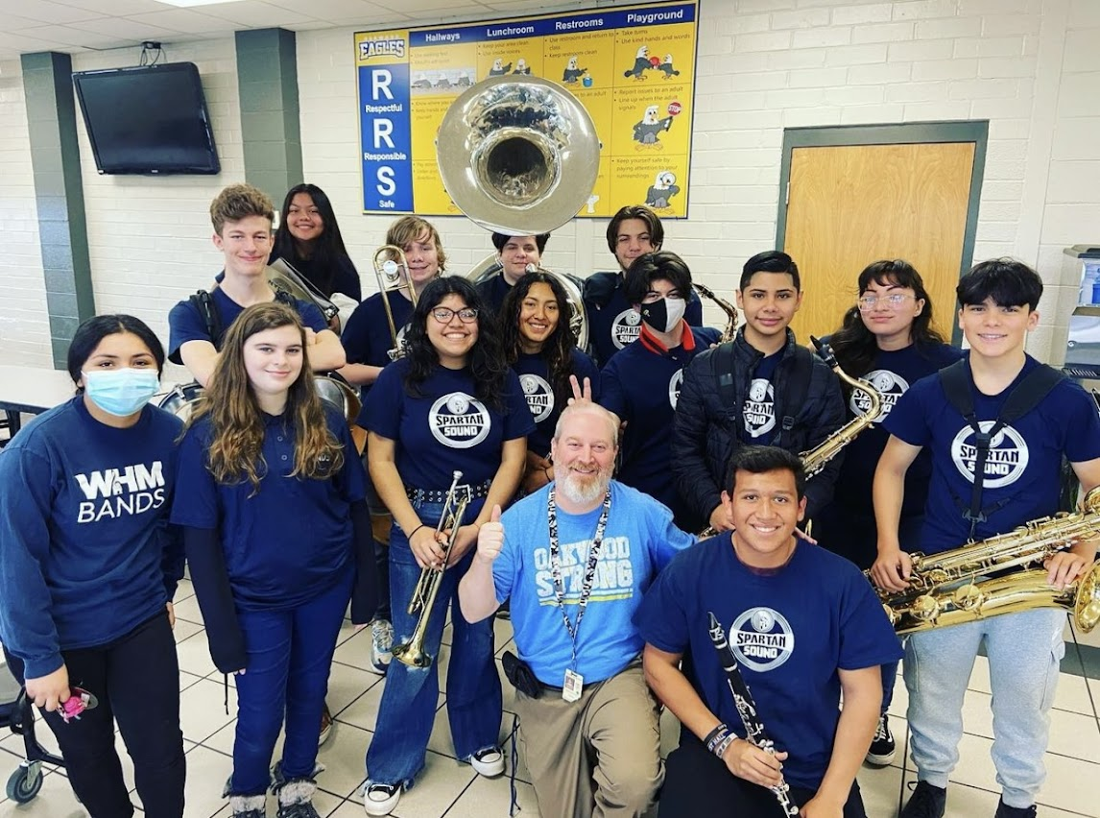

Slide 6
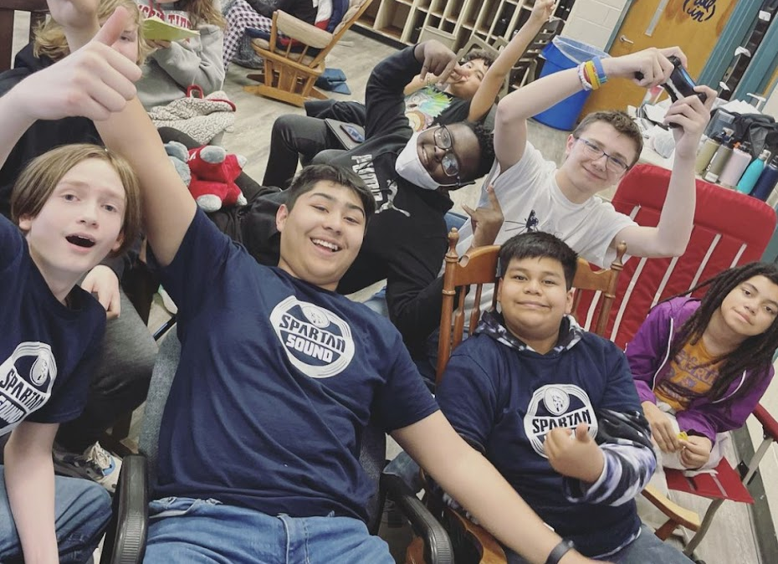
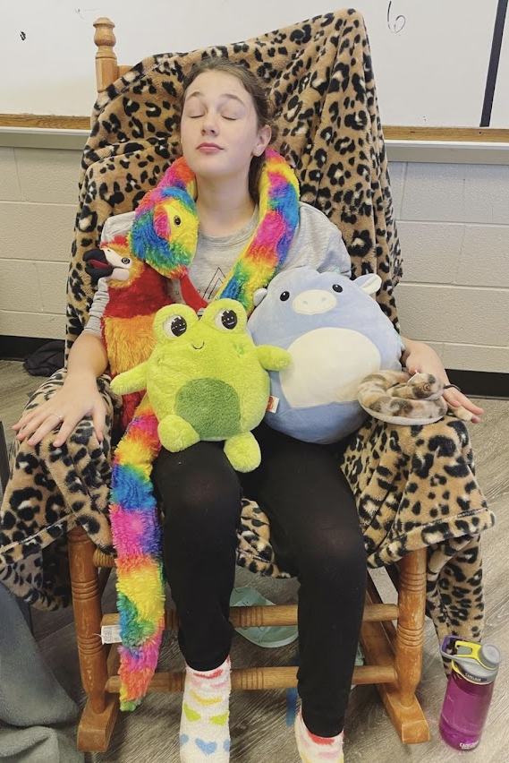
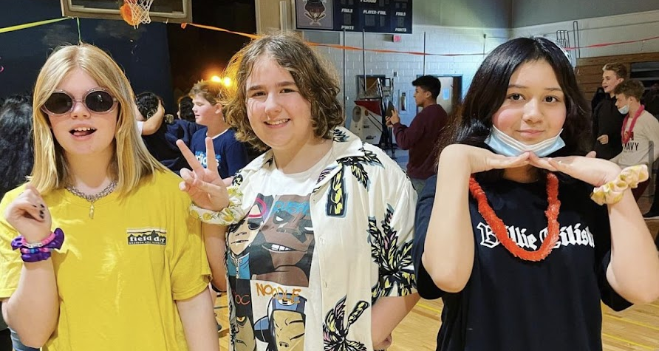

Slide 7
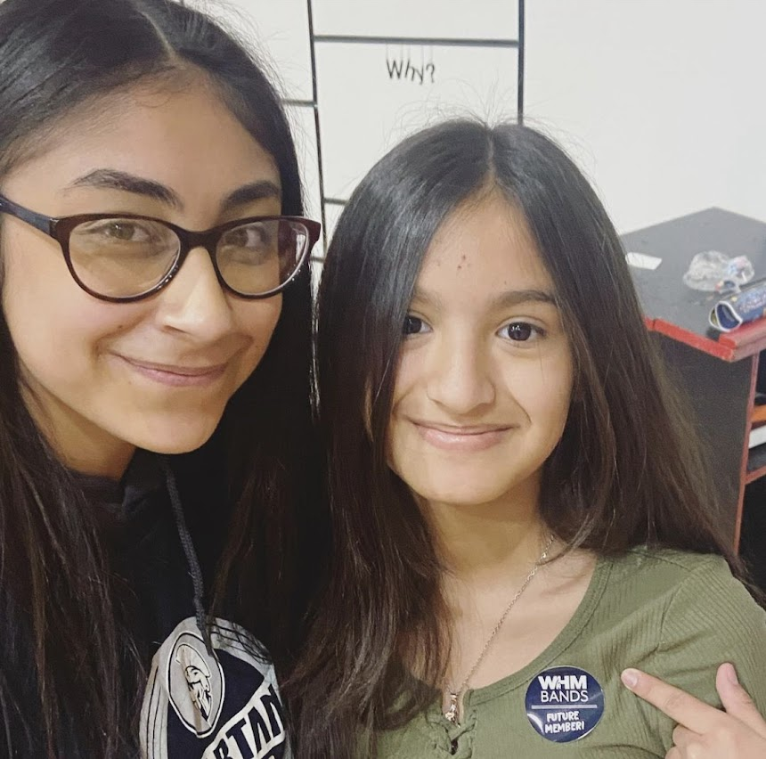
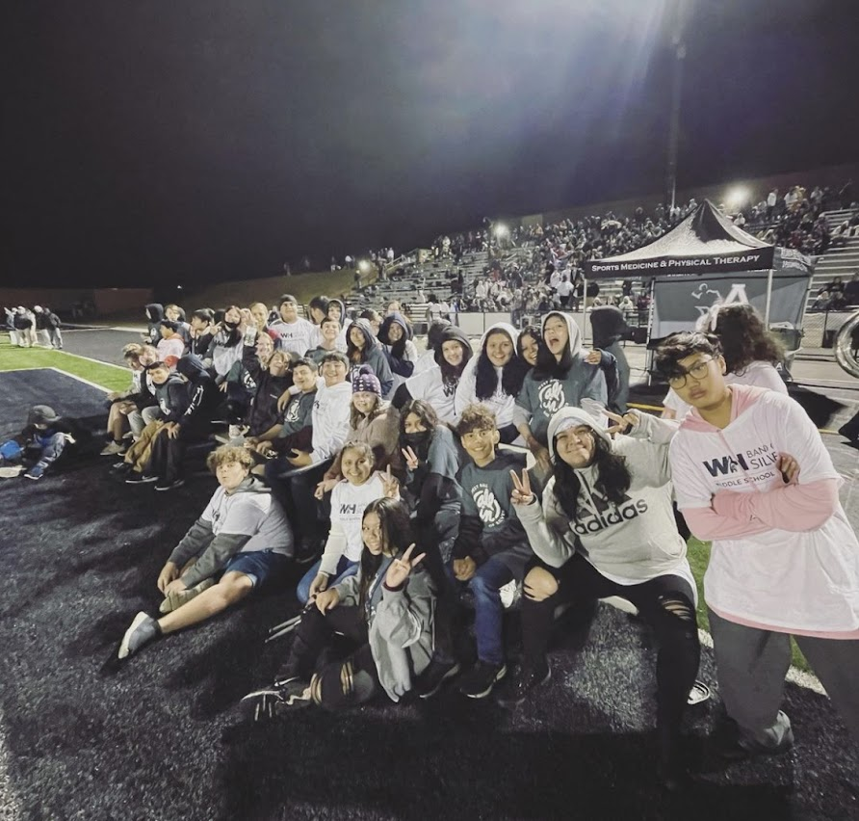
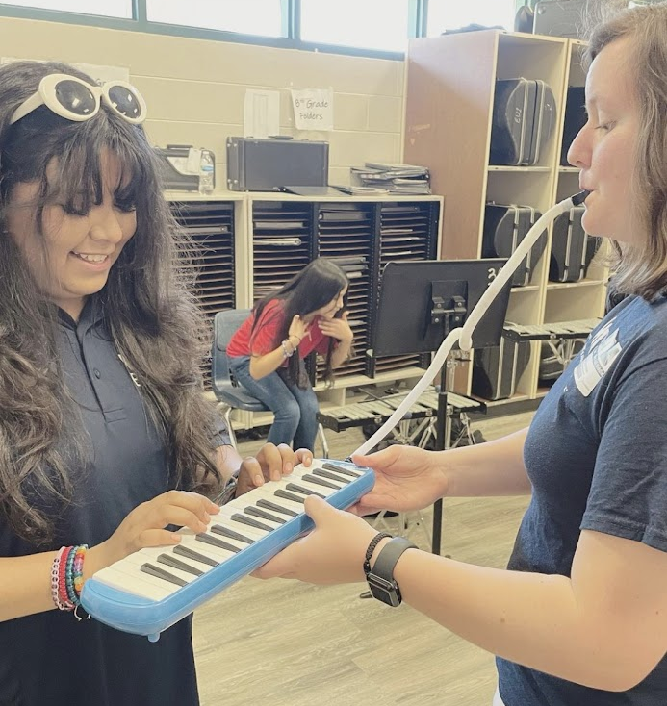
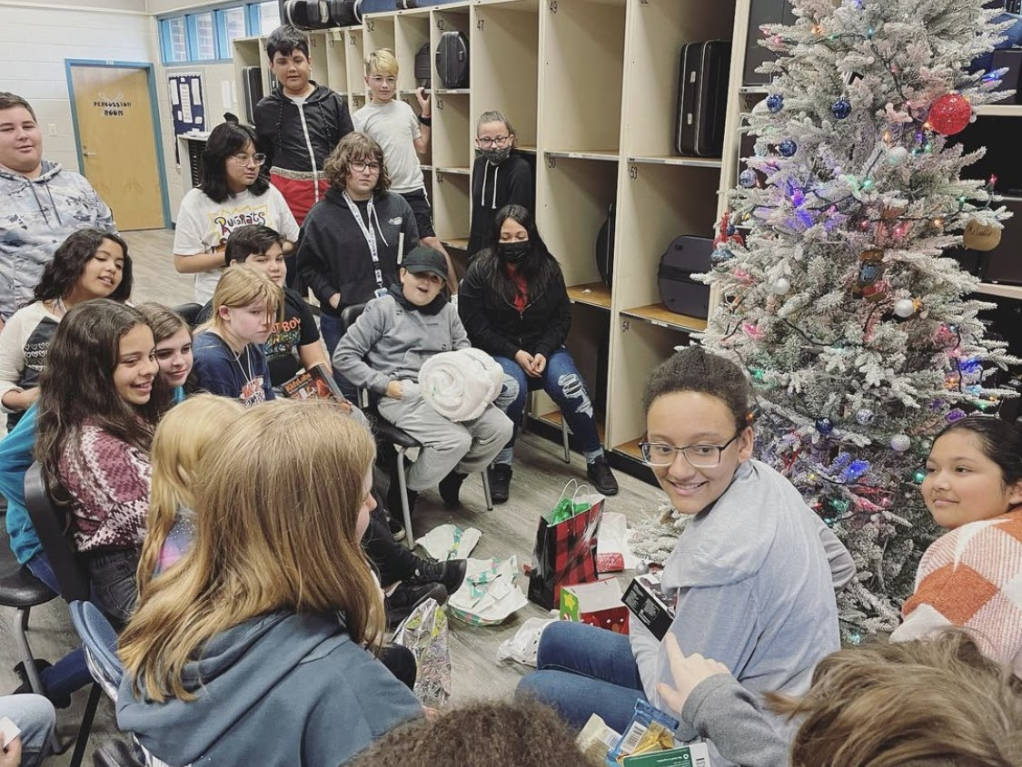
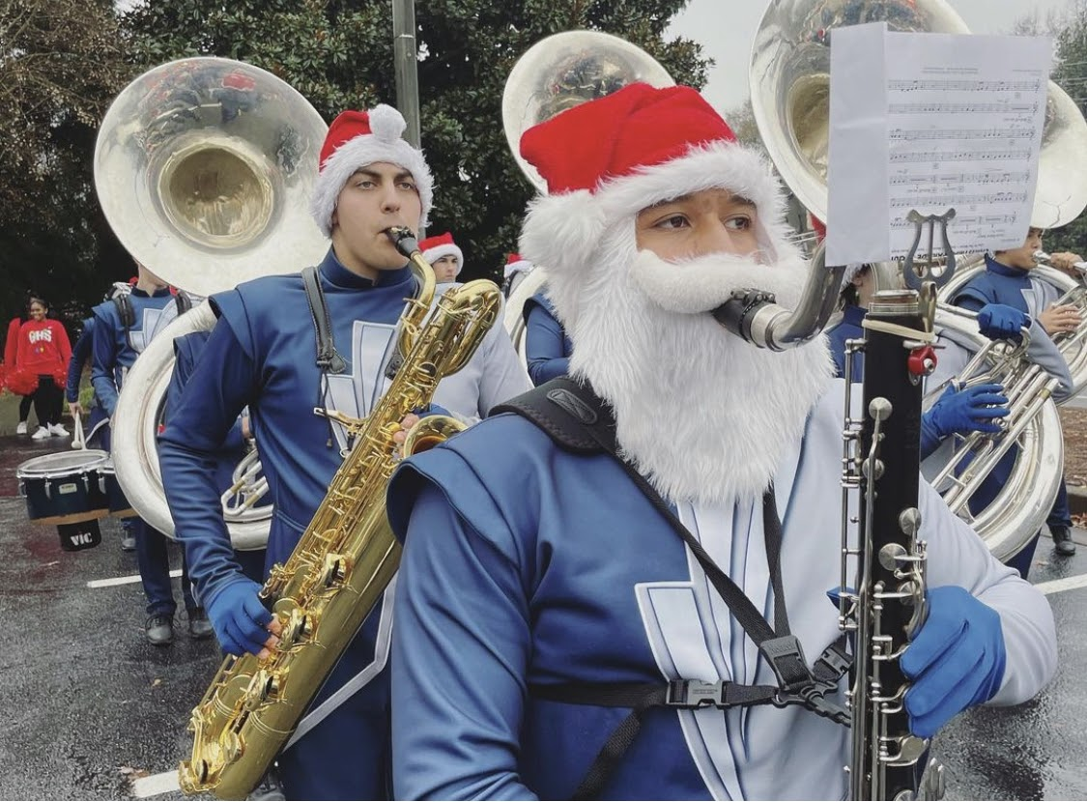
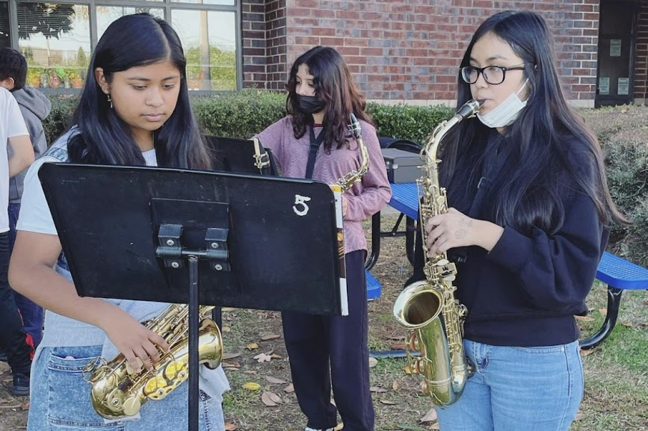

Slide 8
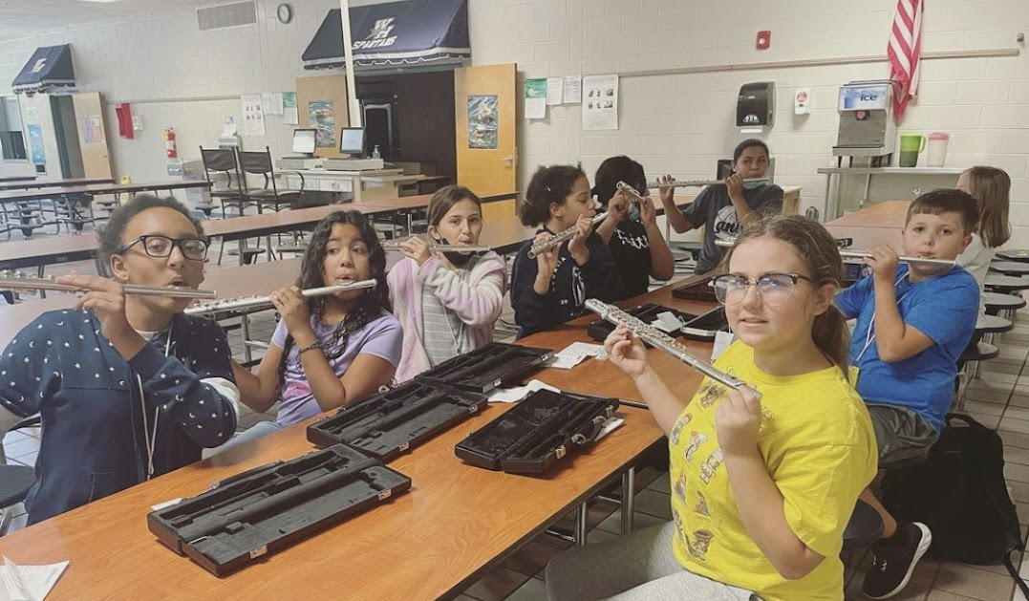
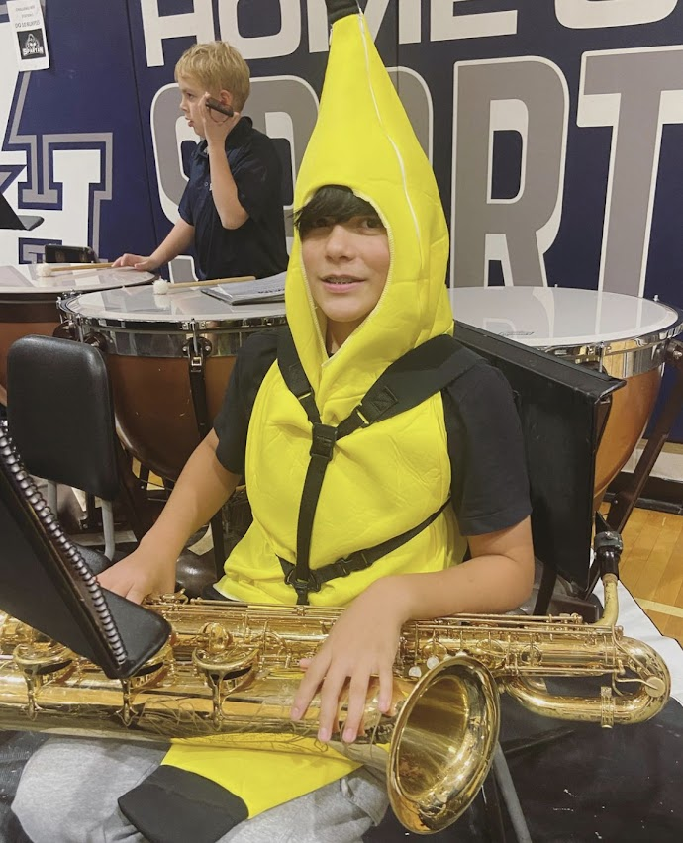
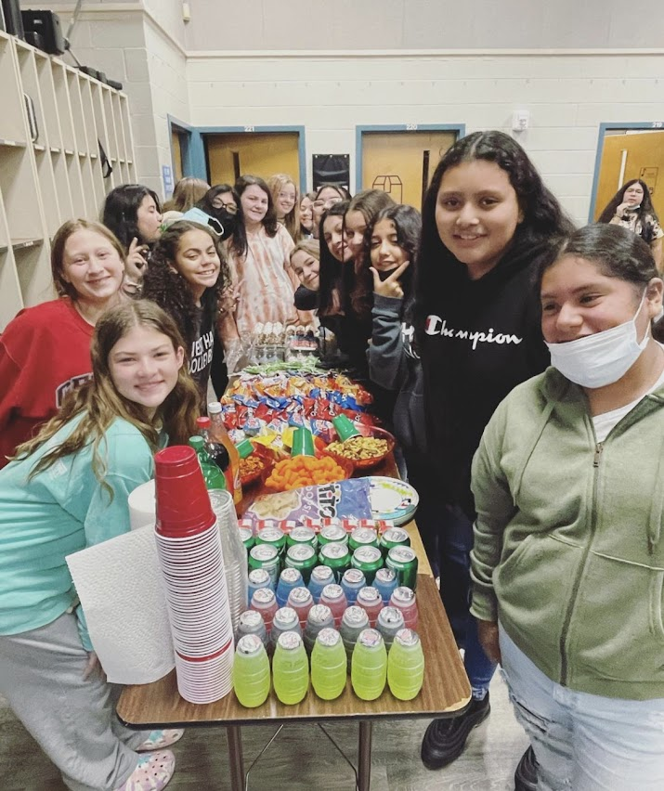
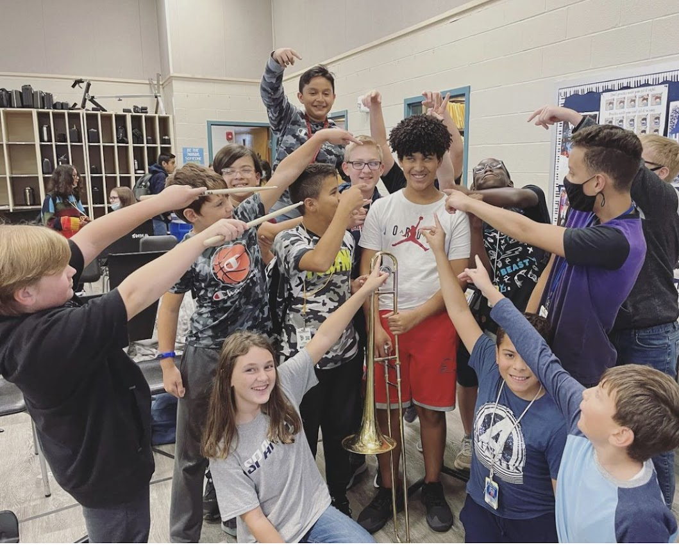
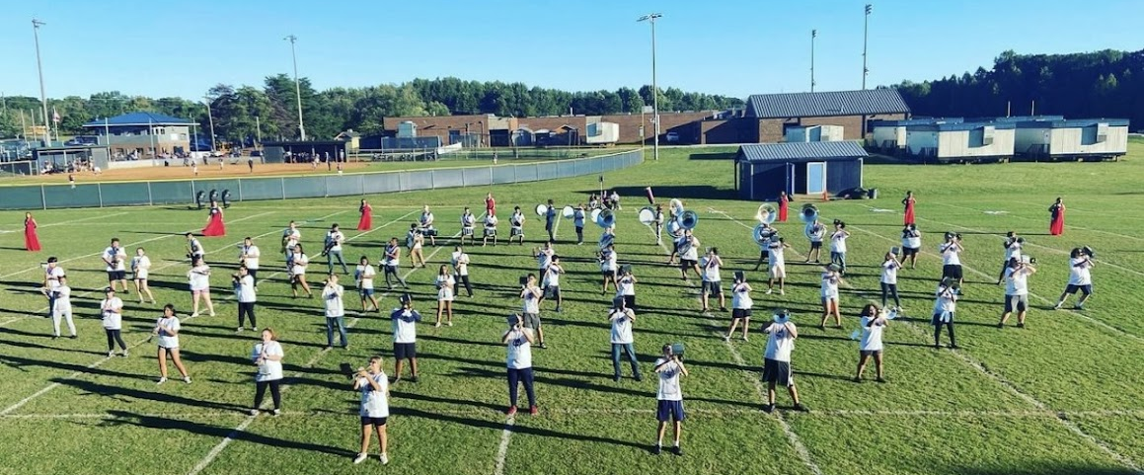

Slide 9
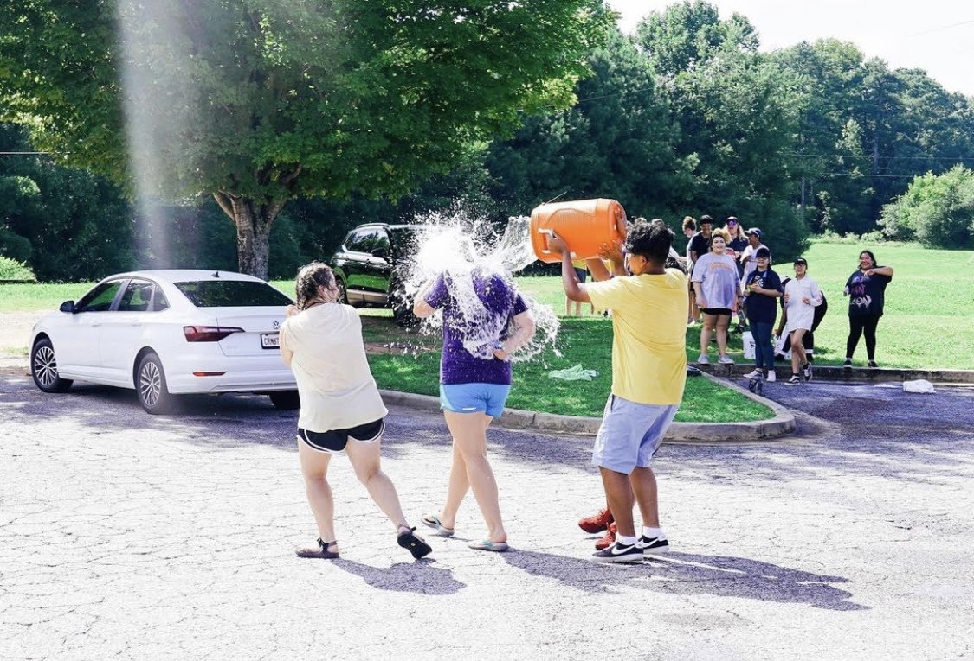
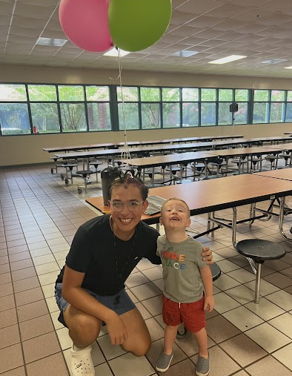
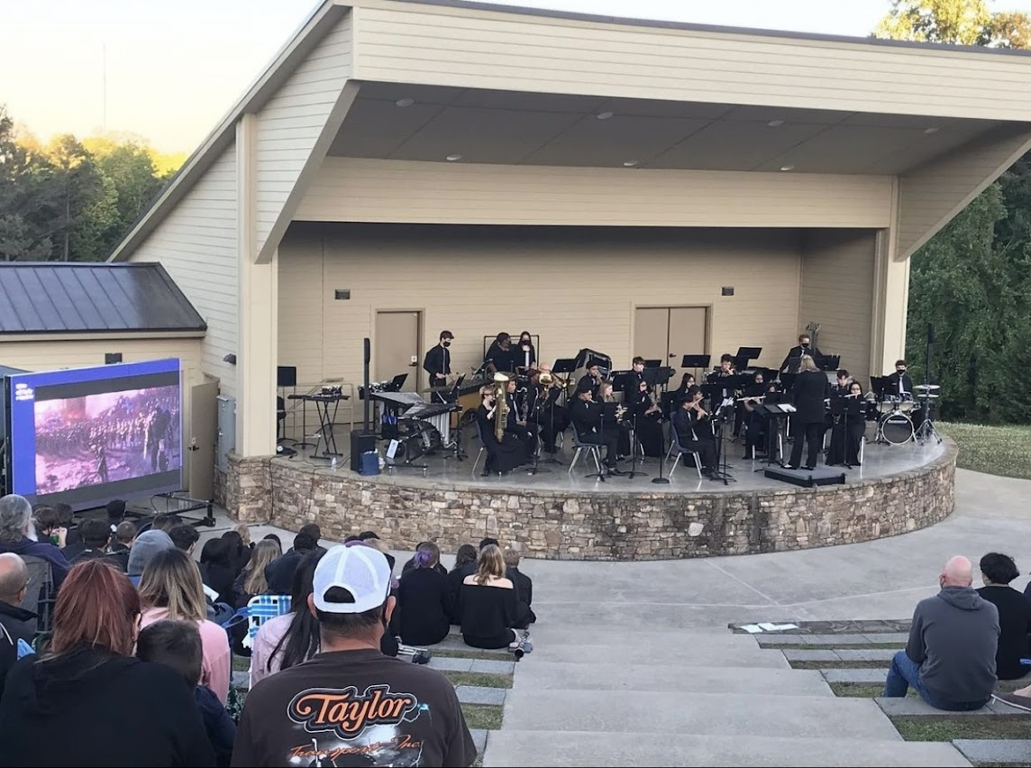
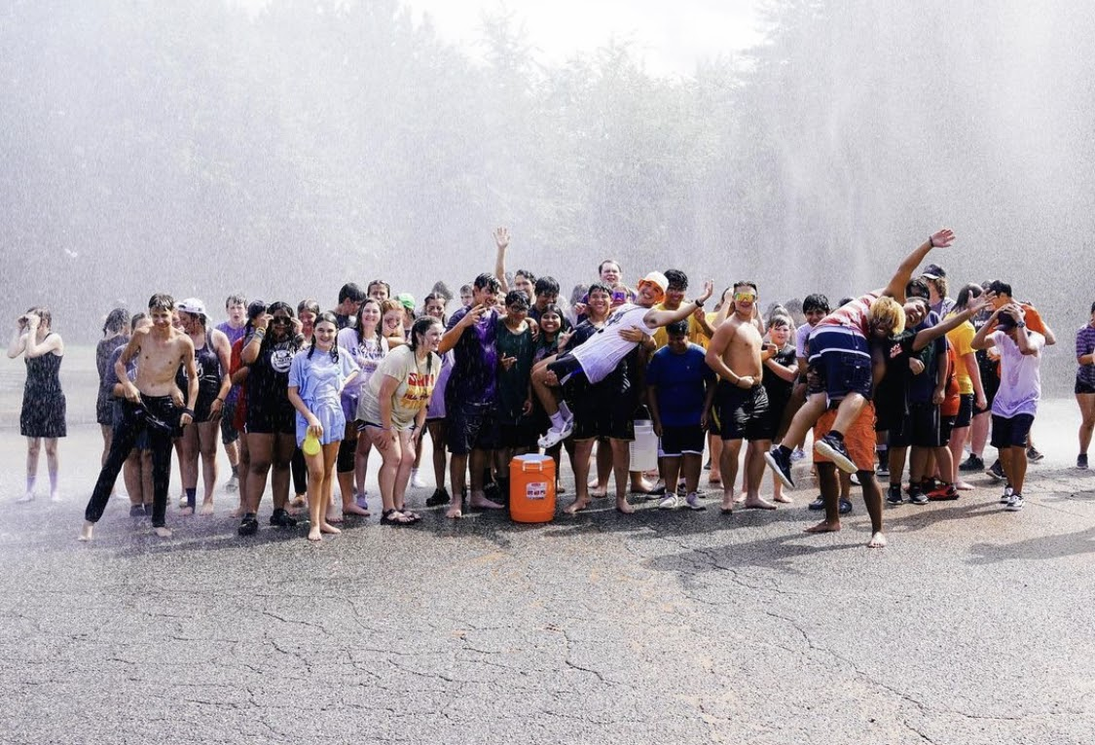
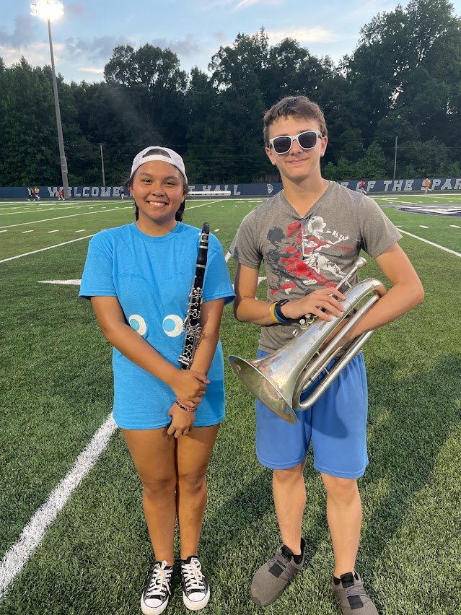
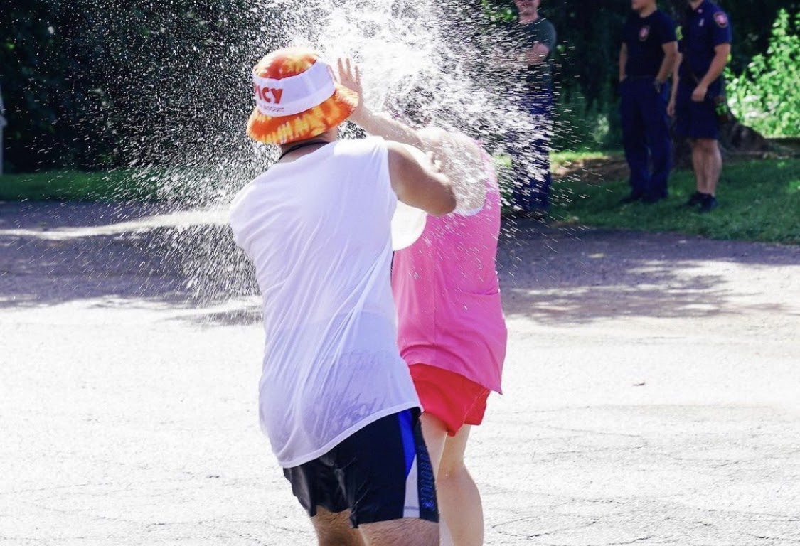

Slide 10
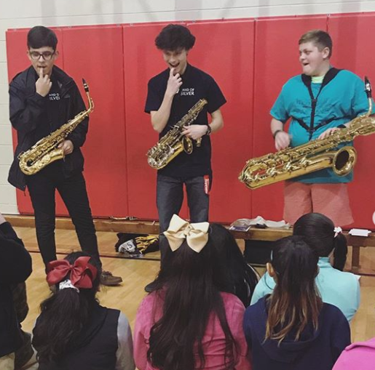
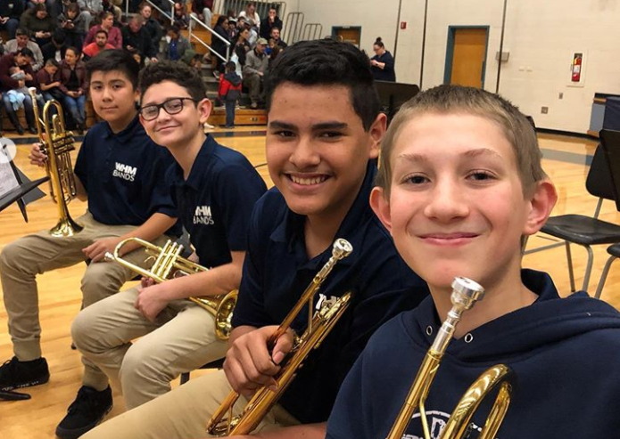
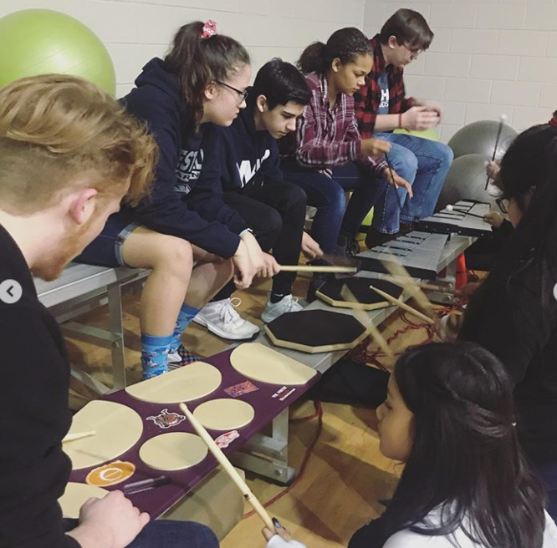
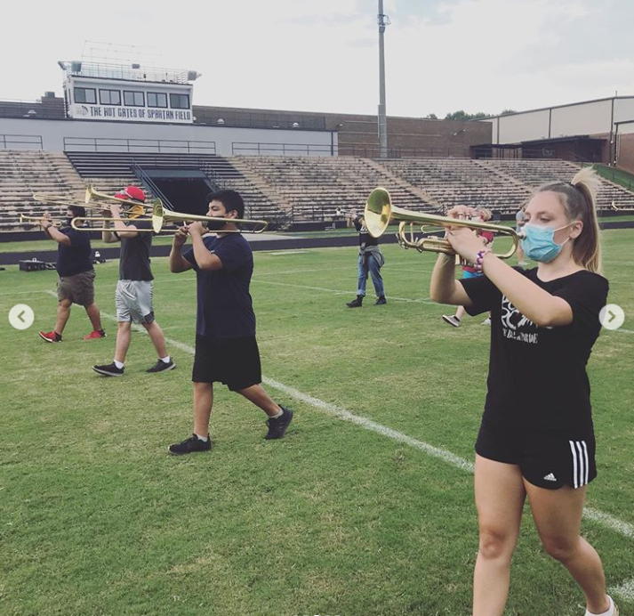
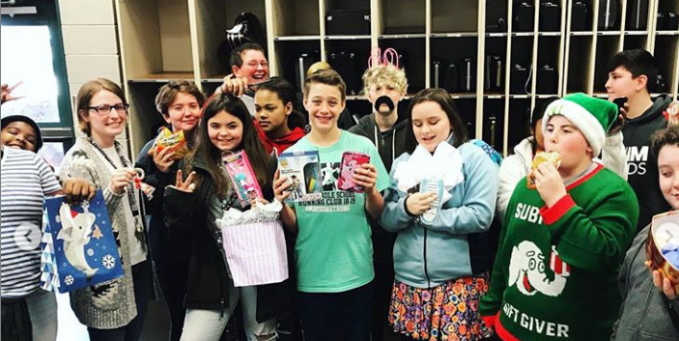
REMEMBER What Band Is Really All About… FUN!!!
Catch Band of Silver’s 2023 Marching Show, featuring some awesome middle schoolers!

Slide 11
Band Parent Perspective
Please welcome bpa president, laura lasseter!

Slide 12
Band Parent Association
Please reach out to these band parents if you need anything! They are wonderful to work with and can answer many of your questions from the perspective of a parent.
President: Laura Lasseter
706-436-4346 or lauralasseter@gmail.com
Parent Liaison: Alejandra Arriaga
678-943-3008 or ronin80_23@hotmail.com
Treasurer/Secretary: Amy Sumrak
amysumrak@gmail.com

Slide 13
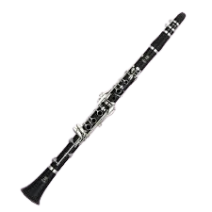
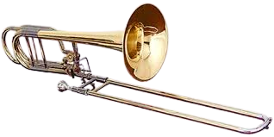
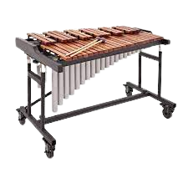
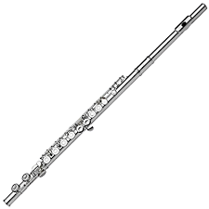
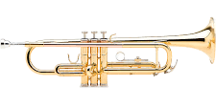
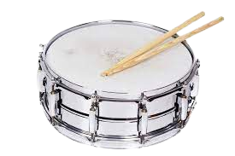
1st Semester Instruments / Instrumentos del primer semestre
Instruments should be rented by August 22nd so they can arrive at the school in time for our first day of playing! / ¡Los instrumentos deben alquilarse antes del 22 de agosto para que puedan llegar a la escuela a tiempo para nuestro primer día de tocar!
PERCUSSION
CLARINET
TROMBONE
FLUTE
TRUMPET

Slide 14
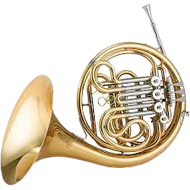
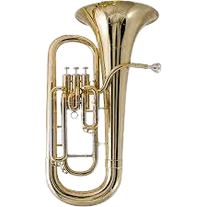
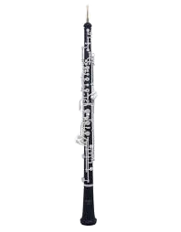
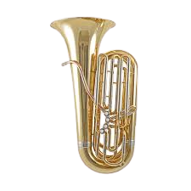
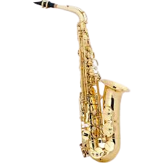
Advanced Second Semester Instruments
Instrumentos opcionales del segundo semestre
OBOE
EUPHONIUM
FRENCH HORN
TUBA
BASSOON
SAXOPHONE

Slide 15
Jackson’s Instrument Rental
Jackson’s Music: alquiler de instrumentos
Jackson’s Music will be here to help us get started on August 21 at 6:00pm!
¡Jackson’s Music estará aquí para ayudarnos a comenzar el 21 de agosto a las 6:00 pm!

Slide 16
BAnd HAndbook / Manual del Programa de Banda
We have physical copies for anyone who wants one. You can also find it on the West Hall band website.
BAND WEBSITE
Tenemos copias físicas para quien quiera una. También puede encontrarlo en el sitio web de la banda West Hall.

Slide 17
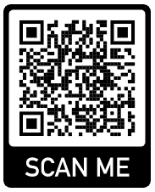
Beginning of the Year Checklist - Complete Today!
Lista de verificación de comienzo de año- ¡Complete hoy!
Scan the Q.R. code, or Google “West Hall Band” and click the first result.
Click “WHMS”
Click “Beginning of the Year Checklist”
Complete at least #1-6 before leaving tonight.
See Mrs. Foster when done!
Escanea el Q.R. código, o Google "West Hall Band" y haga clic en el primer resultado.
Haga clic en "WHMS"
Haga clic en "Lista de verificación de comienzo de año"
Completa al menos del 1 al 6 antes de salir esta noche.
¡Vea a la Sra. Foster cuando haya terminado!

